Slide 1
WEBTECHIES
Group Members
Muhammad Afiq bin Ahmad Kamal 1627133
Syahmi bin Kamarul Baharin 1712939
Rihab Adib bin Othman 1717405

Slide 2
Website that needs makeover: http://realsoda.com/Real_Soda_Sodatorials.html

Slide 3
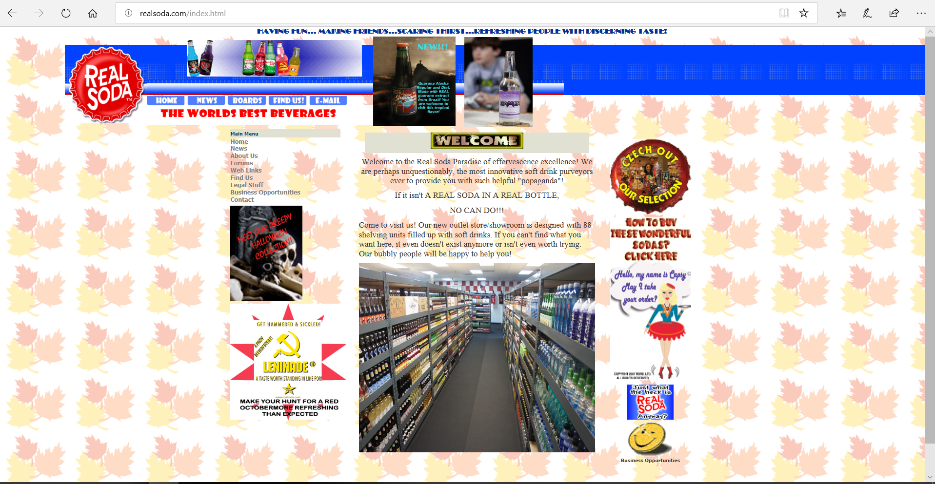

Slide 4
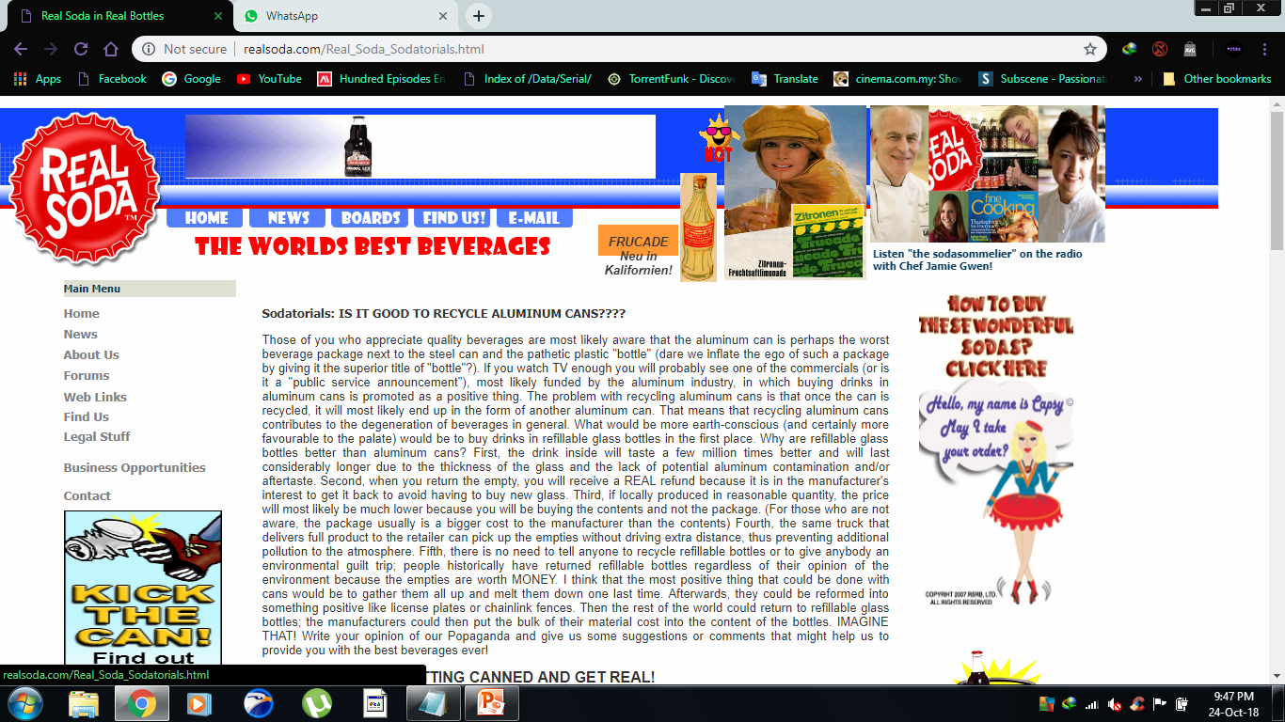

Slide 5
What is the purpose of the site?
Promote soda made by the company
To give information about the product they are selling
A place where customers, collaborators and potential business partners can come and get more details about the company
Who is the intended audience?
- Potential/returning customers
- Potential partners

Slide 6
Identify at least 3 good/bad web elements in the current site
GOOD
Cute and quirky design
Complete details about the company (address, phone number)
Has a proper layout
BAD
Lack of clear call action
Not fully working navigation bar
To much redundant pages
To much unnecessary media
Some of the links and pages are not working

Slide 7
List at least two related or similar sites found on the Web.
Realsodamidwest.com
http://realsoda.com/halloween.html

Slide 8
What are the proposed improvements?
Smaller sitemap, reduce pages
Change layout from F-shaped to Z-shaped reading pattern
Display more professionalism into the design
Remove unnecessary media
Design more proper navigation bar

Slide 9
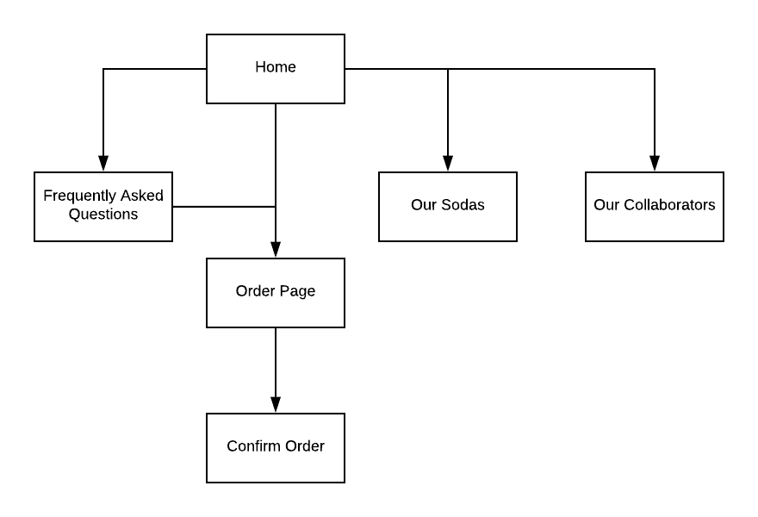
Proposed sitemap for the new website

Slide 10
Proposed wireframes for the website

Slide 11
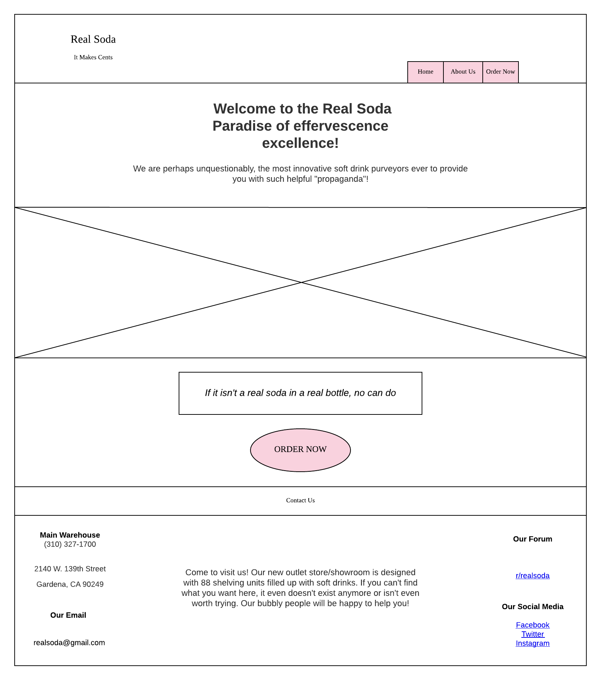

Slide 12
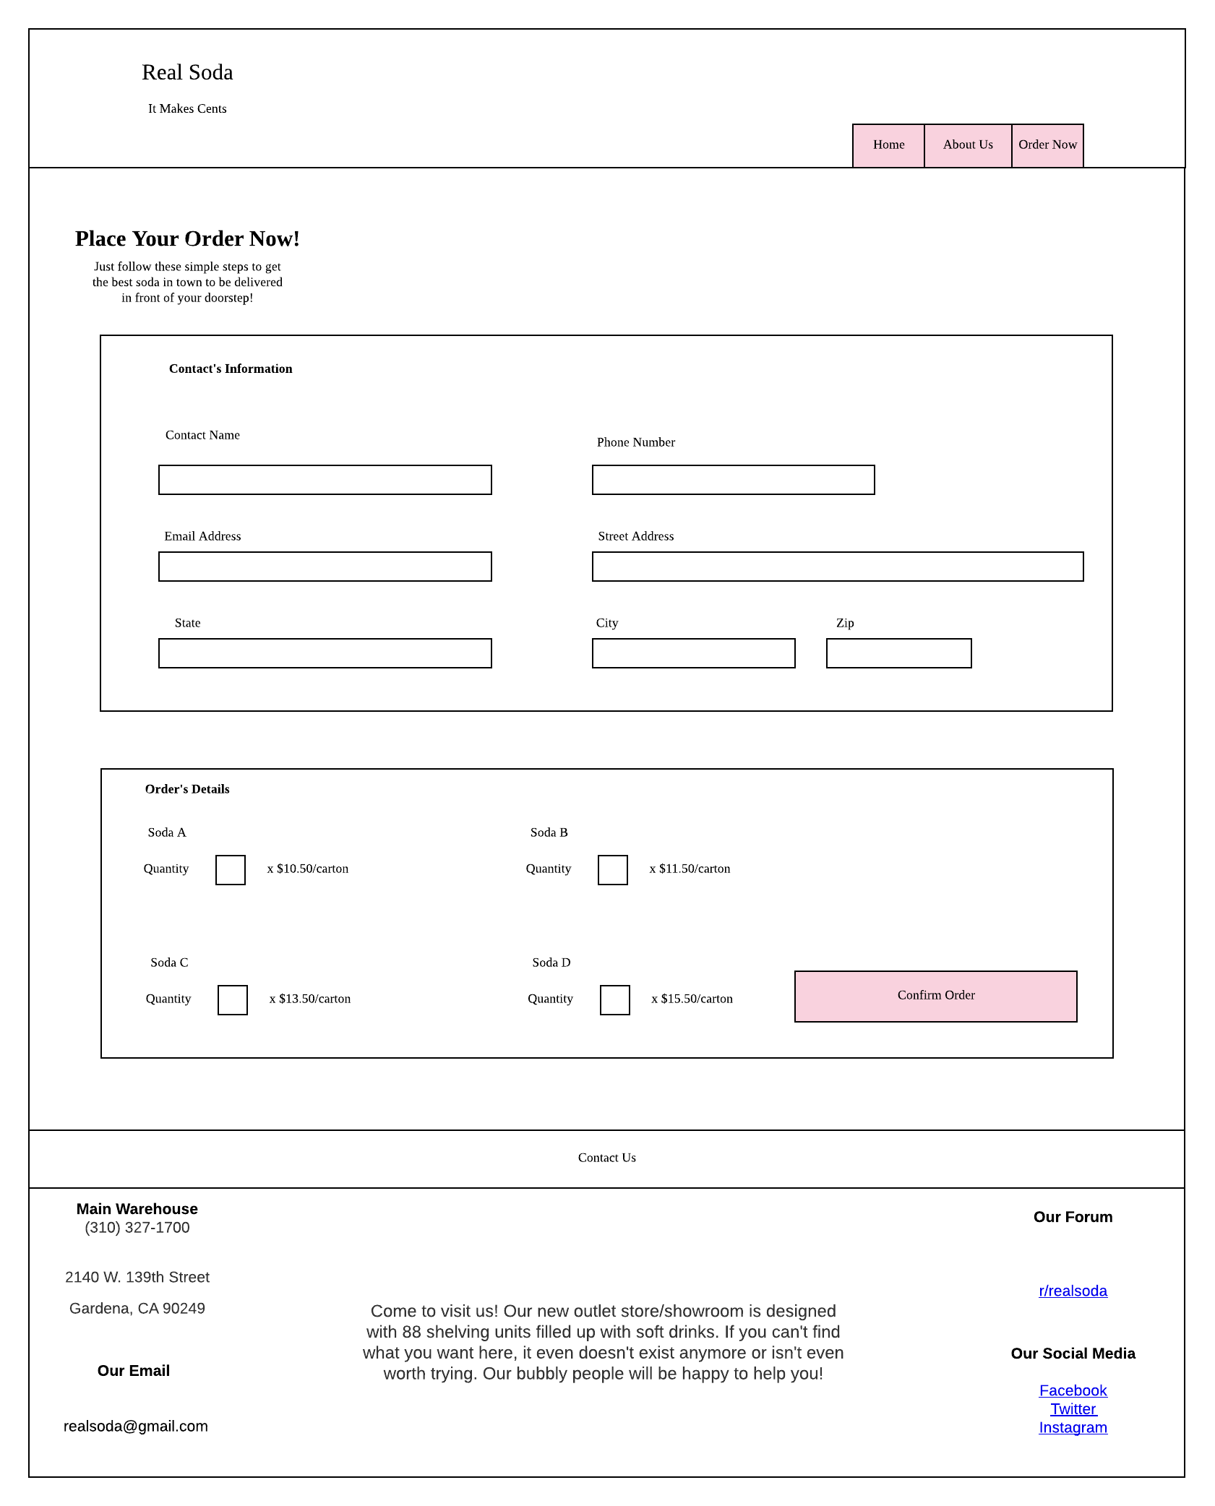

Slide 13
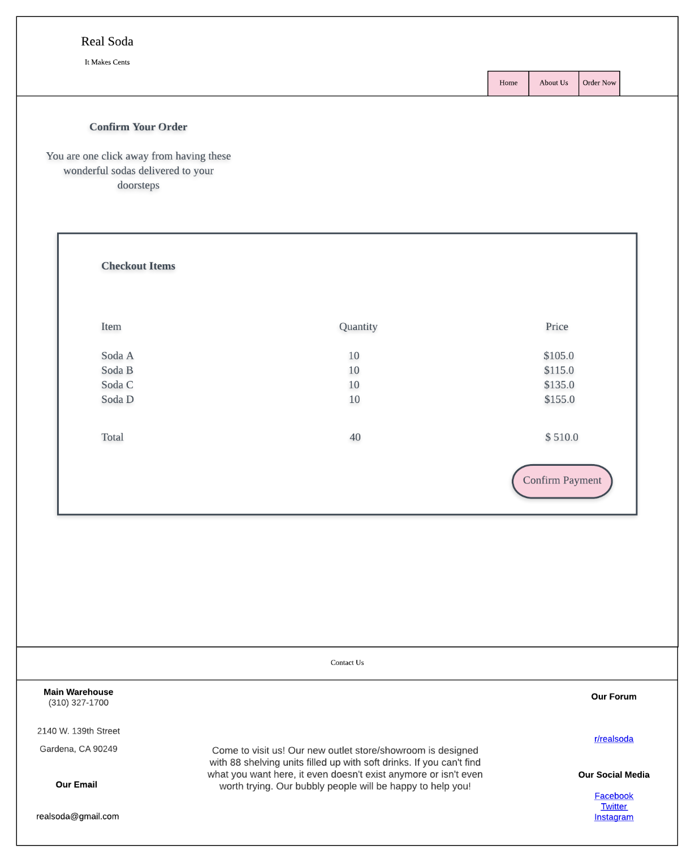

Slide 14
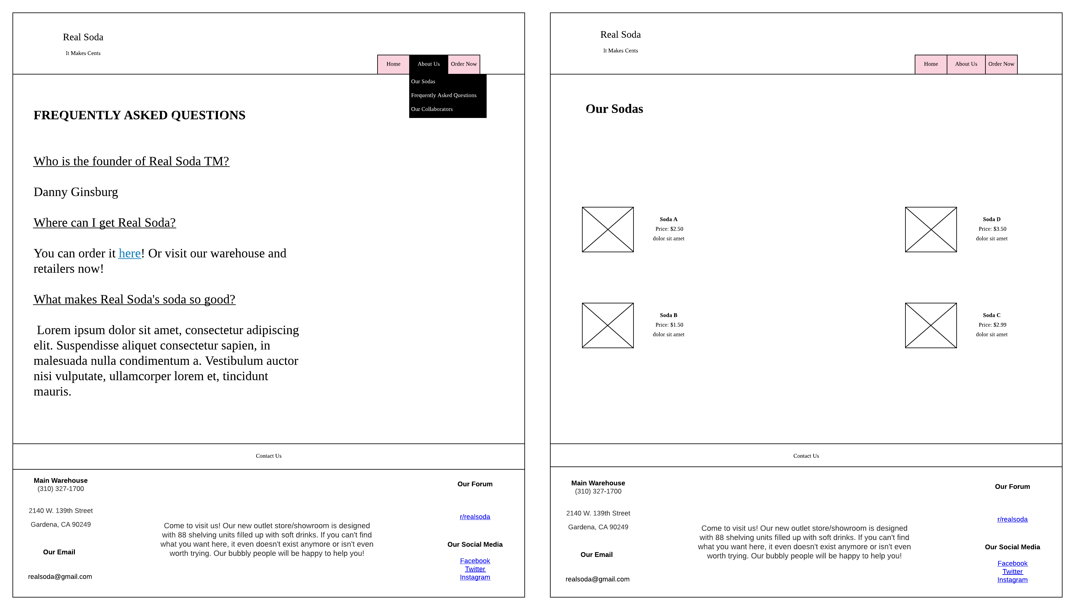

Slide 15
